Slide 1
Welcome Presentation
BOB - SCAS
Presentation prepared for SCAS by EMED Group 2024

Slide 2
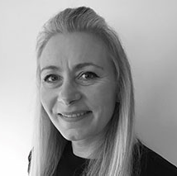
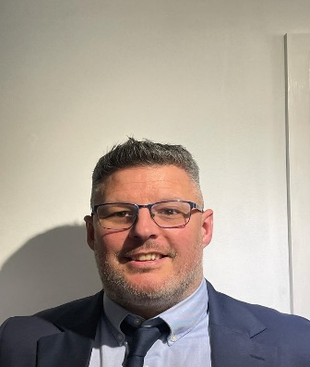
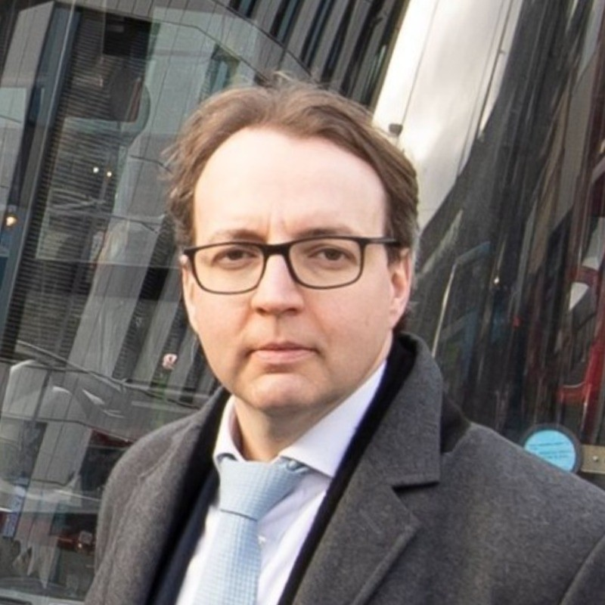
Introductions
Deena Chouhan Head of People Mobilisation and Change
Deena has been an HR professional for over 25 years, beginning her journey as an HR Administrator. She progressed into various advisory and strategic leadership HR roles and supported successful people strategies, including ED&I, HR Programmes, talent development, employee engagement and wellbeing, TUPE, change, and performance management. Outside of work, Deena enjoys cooking, walking, and travelling.
Michele Jackson HR Business Partner
Michele joined EMED in September 2021 after a long career in the army. She is an experienced HR professional with a sound operational understanding. She is highly regarded by her peer group and stakeholders when providing day-to-day support and advice that helps improve people's performance. As an HR Business Partner, Michele displays great influence, collaboration, and technical expertise, which enable her to understand and support the delivery of operational challenges and people priorities within the working environment.
Jonathan Mawer Head of Operations – South East Region
Jonathan Mawer has worked in the NHS for 20 years. He started as a Transport Manager in NHS Supply Chain for 10 years, after which he became a General Manager at Barts Health NHS Trust. Subsequently, Jon joined G4S Kent & Medway NEPTS contract as General Manager, overseeing services across seven hospitals and locations at Guys & St Thomas’s and Kings College where the team transported around 280,000 patients per year.
David Bradford EMED Patient Care Managing Director
David joined EMED Patient Care in 2024. David joined us following a successful career in the bus sector, cumulating as the Managing Director for National Express in the UK, overseeing 4,000 frontline colleagues.

Slide 3
Agenda
Welcome to EMED Group
Our Vision & Values
Who are EMED Group?
New Contract
TUPE – What this means for you
Colleague Benefits
Proposed Consultation Timeline
TUPE Pack and Next Steps
Q&A

Slide 4
OUR VISION
A thriving team committed to pro-actively improving the wellbeing of our communities by enabling access to vital health and care services

Slide 5
EMED GROUP VALUES

Slide 6
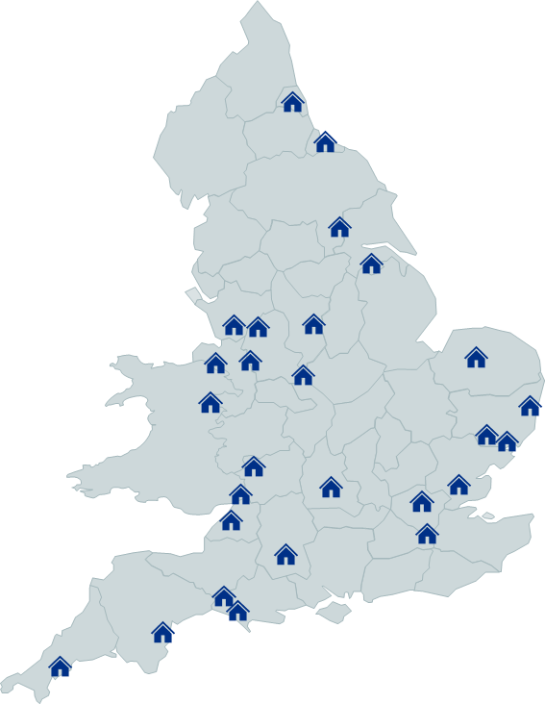
Who are EMED? Leading provider of NEPTS, with a proven track record of delivering success
Group Size and Scale
A trusted partner to the NHS and Local Authorities across 60 contracts
1.4 million patient journeys delivered per annum
2,500 Healthcare Professional frontline staff
1,200 Specialist ambulances
350 control room staff – running multiple 24/7 dispatch centres
55 operational depots
Strong and proven clinical and quality governance team - CQC registered with six ‘Good’ rated inspections in 2022/23
Proven ability to successfully mobilise large-scale contracts
Our Vision
A thriving team committed to improving the wellbeing of our communities by enabling access to healthcare services

Slide 7
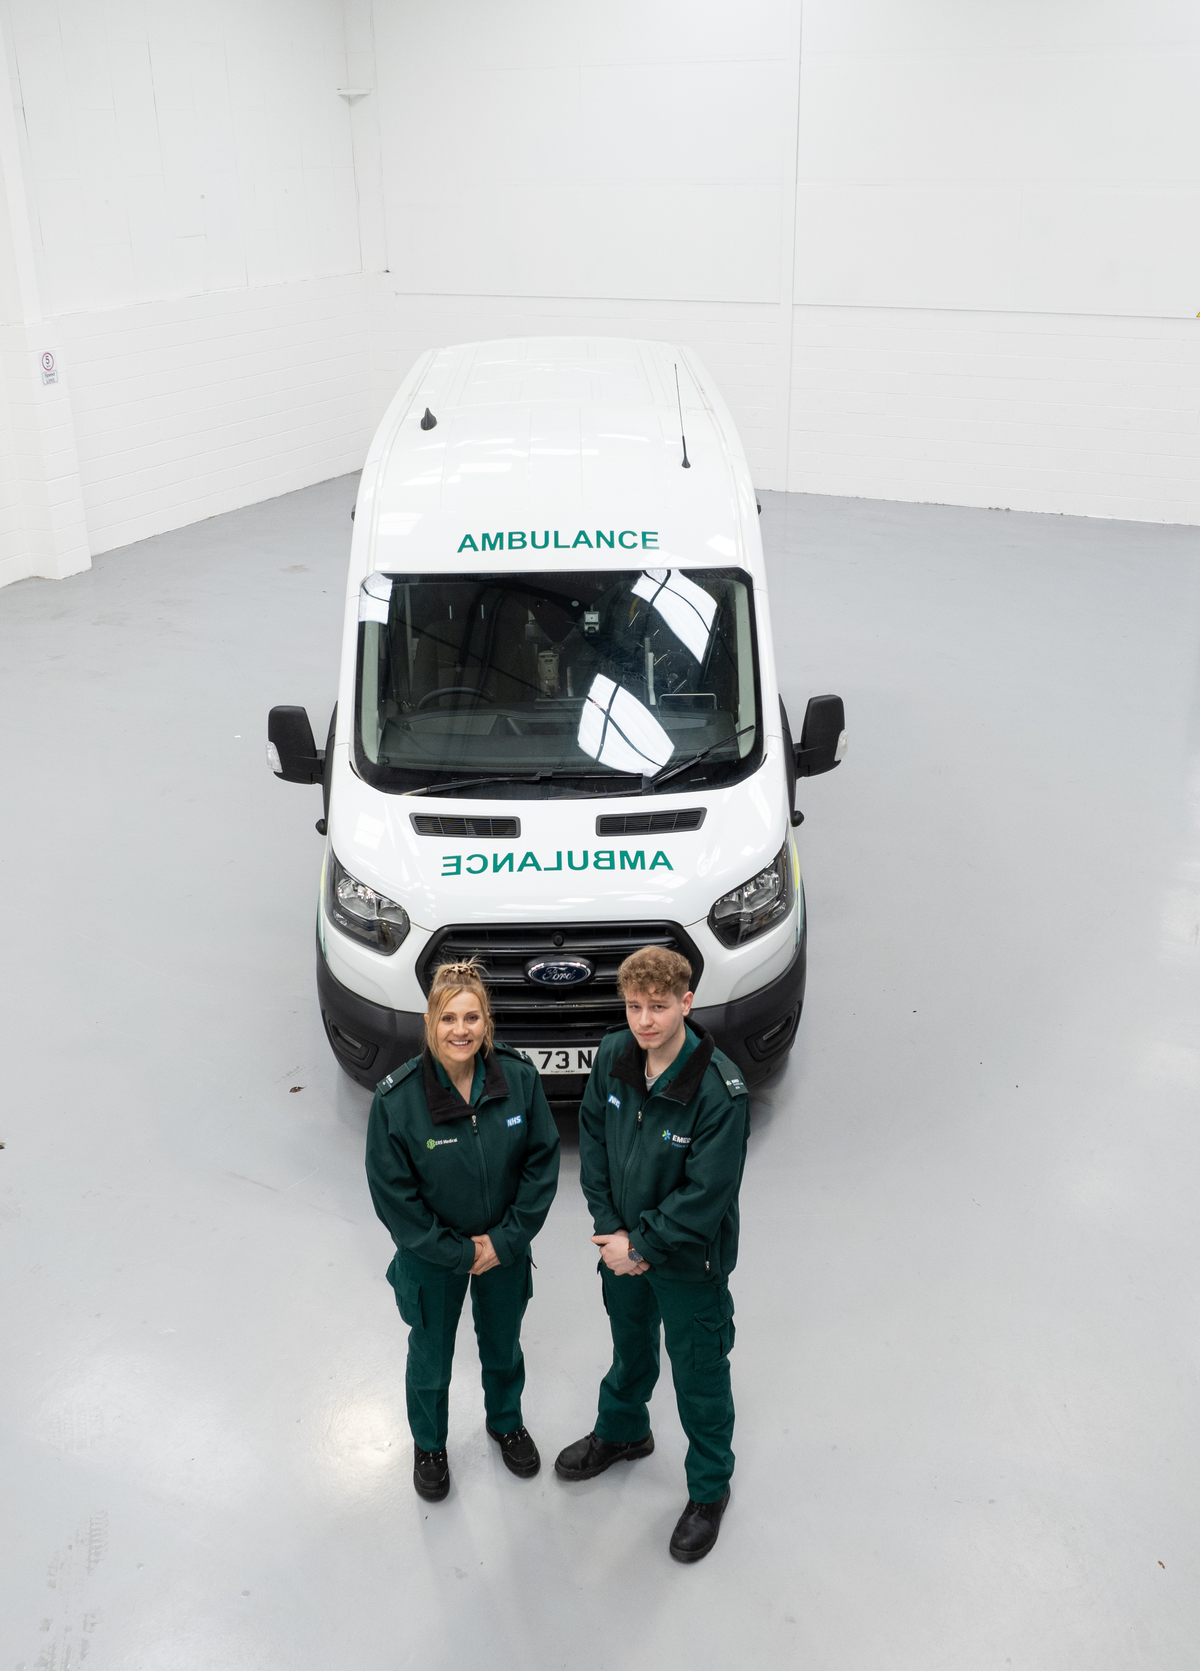
EMED’s Commitment We aim to deliver exceptional support to our patients, colleagues, clients and planet
Our commitment lies with:
Our employees – without you we fail
Giving the very best experience to our patients
Developing strong relationships with the healthcare system to ensure we provide a service that meets the needs of the system
Ensuring we learn from our mistakes and having a culture of openness and transparency

Slide 8
GROUP STRUCTURE Divisional structure ensures bespoke services to meet client and patient needs
NEPTS
High dependency services
Falls / Triage Service
GP Urgent / OOH support
Neo-natal Services
Patient Drop-in Services
Special Educational Needs (SEN) Home to School
Demand Responsive Transport (DRT) services to rural communities
Secure and Mental Health transport services
S135 and S136 support
Inpatient admissions after AMHP involvement
Bedwatch and companion support
Pathology
Virtual Ward equipment
In-home diagnostic support
Separate services harnessing operational, financial and functional synergies

Slide 9
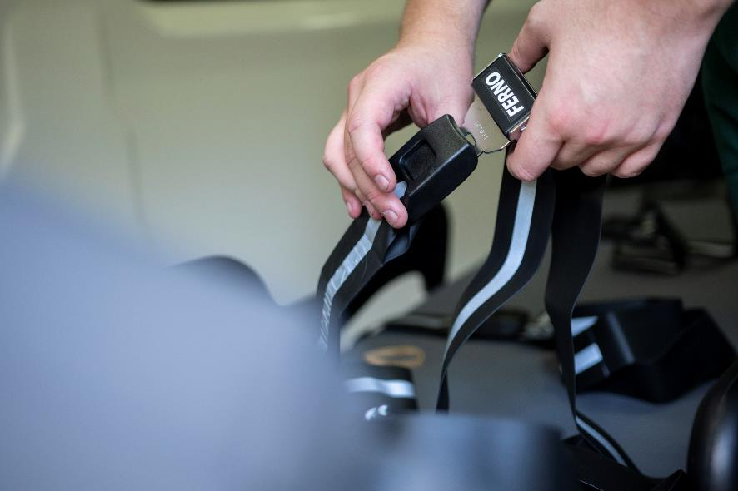
NEW CONTRACT EMED Patient Care
Non-Emergency Patient Transport
HDU (High Dependency)
Bariatric
Mental Health Safe Care
Renal
Dispatch & Control
Call Centre

Slide 10
NEW CONTRACT
Base Locations - BOB
We are looking to secure operational bases in the following areas:
Base 1 – Oxford
Base 2 – Reading
Base 3 – High Wycombe
Base 4 – Camberley
Base 5 – Aylesbury
Base 6 – Banbury
We are working with SCAS management to look at the possibility of utilising existing operational locations. These locations are subject to change.

Slide 11
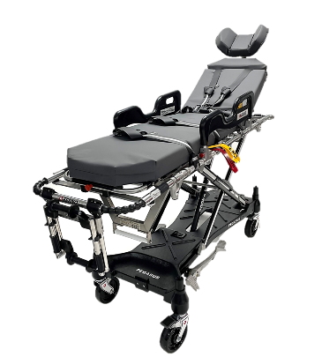
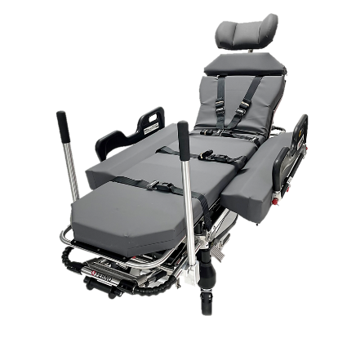
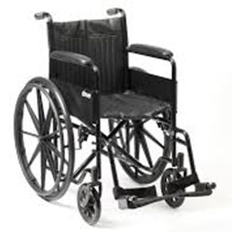
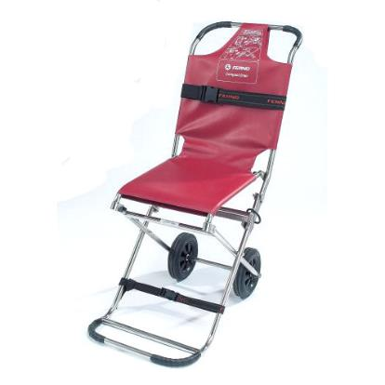
NEW CONTRACT Main Equipment
Pegasus Stretcher
Megasus Stretcher
Crew Wheelchair
Carry Chair

Slide 12
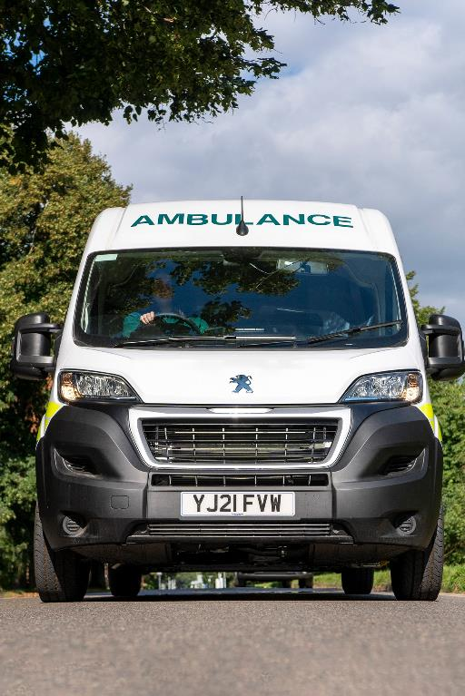
NEW CONTRACT
Operations and Call Centre - Ways of Working – Post Transfer
Timegate, which is a time and attendance system that we are currently implementing throughout the organisation so this will follow post transfer.
Training will be provided on our Cleric booking and Daktela telephony system.
Mobile phones/electronic data system (PDA) will be supplied.
Using vehicles that will consist of a mixture of HDU, stretcher, multi-seated, bariatric, wheelchair accessible vehicles and cars. Vehicle familiarisation will be carried out before the transfer.

Slide 13
NEW CONTRACT
Operational Software Systems – Post Transfer
BambooHR: This is a cloud-based HR System, which holds all personnel, absenteeism, and training records. It also acts as a repository for business management system procedures, recruitment, onboarding and offboarding and is where all templates, forms and policies are located.
FleetCheck: This system is used to record and track all fleet related assets as well as record compliance, including servicing and MOTs.
Crystal Ball & Lightfoot: Which is used to track vehicles and to aid incident management.
Radar Healthcare: Radar is our compliance database offering a single gateway solution for all compliance, incident management, complaints, and H&S matters.
Office 365: This solution provides cloud-based solution to access files and software packages such as Word, Excel, SharePoint, and Teams.
SAGE: We use SAGE for our financial and payroll matters.
Licence Check: is the system that we use to ensure that all drivers have a clean driving licence, which is checked annually.
Cleric: Is used for our booking, control, and dispatch system
DBS (Reed Screening): Our DBS portal is used to update DBS details on a 3-yearly basis.

Slide 14
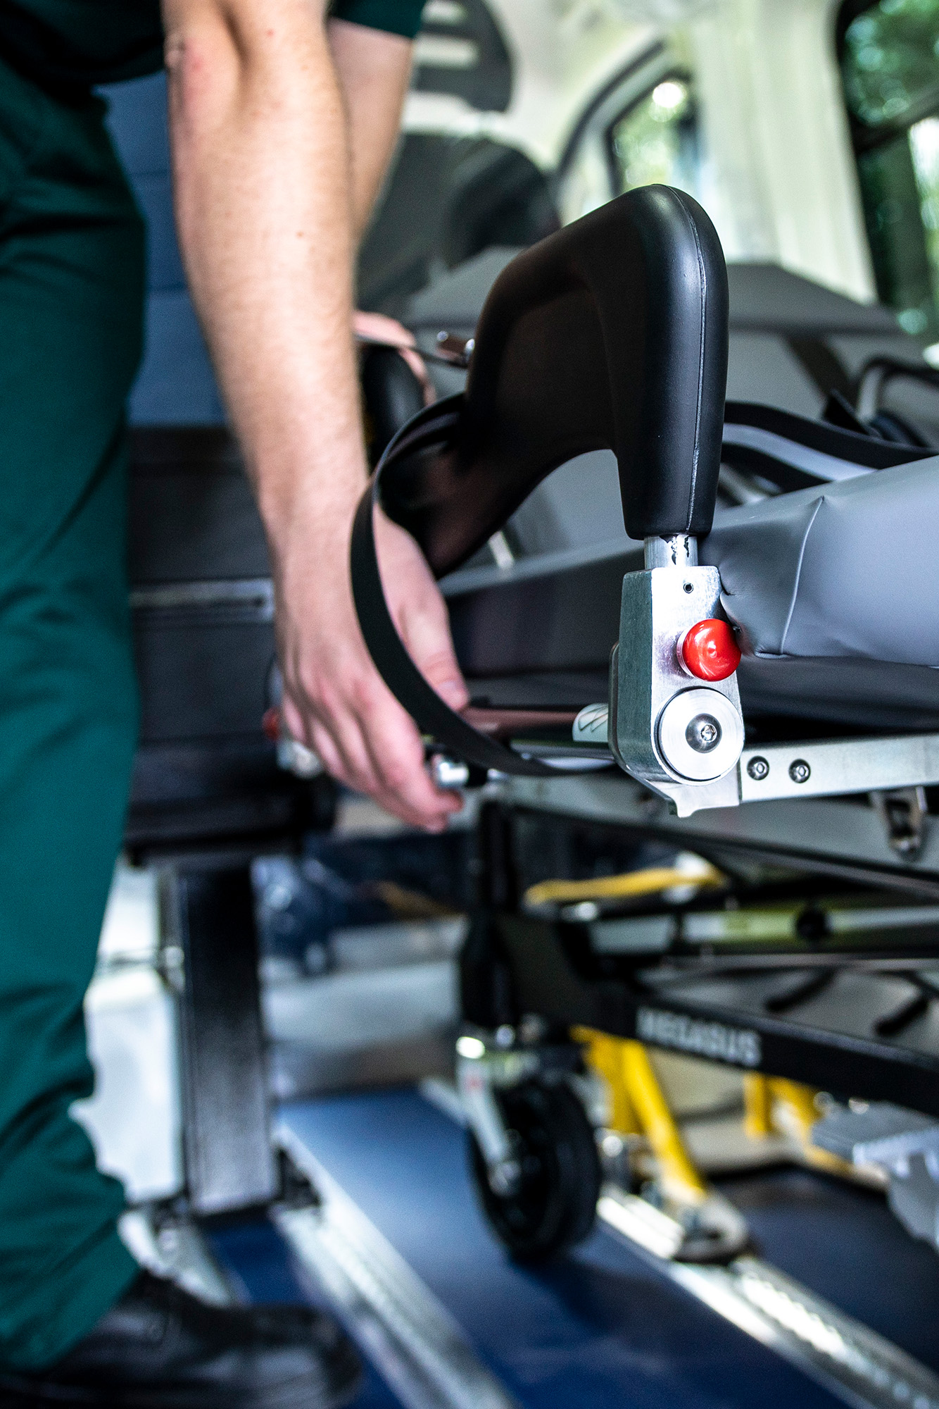
TUPE – WHAT THIS MEANS FOR YOU
TUPE stands for Transfer of Undertakings (Protection of Employment) (amendment) Regulations 2014.
TUPE legislation designed to protect employees who are affected by a transfer of a contract or business from one employer to another.
Current main terms and conditions transfer with you
From a day-to-day job perspective, it’s likely that very little will change.
We may need to bring in new equipment, systems or ways of working that may improve the way that we work. It may also be necessary to align certain things, such as the annual leave year and pay dates.
Subject to any necessary changes or ‘measures’, your existing terms and conditions of employment will transfer with you to EMED Group.
Sometimes not always possible to replicate exactly one or more of your terms, even with the same provider. In these cases, we will inform you and discuss with you how we may provide comparable alternatives.

Slide 15
TUPE – What this means to you (Cont.)
PENSIONS
Where applicable, an application to NHS Pensions will be made as part of the transfer process. NHS Pensions will confirm if you are eligible to remain in the NHS Pensions.
If our application not successful, placed into a defined Contribution scheme with matching contribution rates up to a maximum of 6%. Eg current employee % is 6% we will match 6%. (All in line with Pension Fair Deal Guidance)
For anybody not in the NHS pensions you will be auto enrolled into our NEST Pension benefit scheme.
EMED will propose some Intended Measures of Change from Date of Transfer – Eg’s
Our pay date will be last working day of each month.
Our Annual leave year is April to March.
Base locations & uniform will change.
Our Polices & Procedures will apply from date of transfer unless contractual under Agenda for Change.
Any annual pay reviews will take place in April each year.
Our equipment including fleet vehicles will be in place from date of transfer.

Slide 16
TUPE – What this means to you (Cont.)
Contract Reviews Post Transfer
Roles
All current roles and staffing levels that are in scope to transfer under TUPE will remain in place from date of transfer
At this stage we do not envisage any roles being placed at risk of redundancy.
However, if any changes are necessary in the future due to Economic, Technical or Organisational (ETO) reasons the required consultation process will commence.
Other Reviews
It may also be necessary for EMED Group to undertake a review of operational activities to ascertain if any changes are required to sustain the long-term success of the contract and meet the contractual obligations of the commercial contract agreement e.g. Overtime, Shift Patterns, rotas, job title etc. This will all be reviewed after date of transfer.
Any changes that are necessary, will be proposed in full consultation with affected employees.
Right to Work Documentation & Background Checks
We will be requiring all employees to produce documentation that shows they are legally entitled to work in the UK and also copies of current driving licences. Evidence will need to be provided at the engagement onboarding joint 121 consultation meetings.
Pre-Employment Screening
All employees will be required to complete a medical questionnaire to ascertain any reasonable workplace adjustments and attend any subsequent Occupational Health appointments as required.

Slide 17
Colleague Benefits
Life Assurance Scheme – protection to the value of £5,000, available to whomever you choose as one-time tax-free payment if a death occurs during service (not applicable if in the NHS pension as DIS scheme already in place or other independent DIS Scheme transfers with you)
Cash Plan Benefits – helping you to pay for everyday healthcare costs and provides ongoing health and wellbeing benefits from just £6.95 per month.
24/7 GP Virtual Booking for Consultation Appointments – Providing 24/7 appointments with a Private GP at any time, an access link and code will be shared with post transfer.
Service available to you, your partner, any dependent children in the same household.
No cost to you for this service – private prescriptions available – pay for the cost of the medicine.
Second Opinion Medical Service – access for you and your family members to a second opinion medical service, should you have any concerns regarding a diagnosis or treatment plan.
Notes:
Life Assurance - From 1 June 2024, all employees will be provided with £5,000 death in service cover, which is paid to your nominated beneficiary(ies) upon death.
• The benefit is paid to your beneficiary(ies) tax free and does not attract Inheritance Tax and will not form part of your Estate. • Anyone with historic Life Assurance cover will retain it at their current level. • No cost to you for the cover.
What is Life Assurance and what cover is in place? • Cover will cease when you reach age 75, or you leave EMED. • You will not need to provide any medical evidence or fill out any forms. • There are no exclusions based upon the cause of death. • You will continue to be covered during periods of absence, once you are a member or the Scheme. • It is important to ensure you have an up-to-date Beneficiary Nomination in place.
Health Cash Plan • Covers everyday healthcare costs such as Dental, Optical, Physio and Chiropractor. • Provided on a voluntary, self-funded basis with access to preferential rates. • Up to 4 children included for free on single cover. Partners can be added for an additional cost. • You will not need to provide medical evidence and pre-existing conditions are covered Health Cash Plan • Discounted gym membership available. • In addition to “traditional” therapies, such as Physiotherapy, Chiropractic Therapy, etc you can also claim for certain “alternative” wellbeing therapies such as Reflexology, Hypnotherapy and Indian Head Massage. • Allergy Testing can also be claimed for.
Virtual GP • Remote Digital GP – 24/7 Private GP consultations by video call or over the telephone. Service provided by Health Hero. • Book appointments via the app or online with choice of appointment times and male/female doctors. • No cost to you for this service (excluding prescription charges).
Service available to you, your partner and any dependent children in the same household. • Private Prescriptions available (you will need to pay the cost of the medication, not the ‘prescription nhs cost’
Medical Second Opinion Service • Provides a supplementary expert opinion from a specialist in the relevant medical field. • Can provide peace of mind about a diagnosis and allows you to ask questions about any proposed treatment or discuss alternative treatment options. • Conditions such as Cancer, Heart/Coronary, Organ Failure, MS, Stroke included. To be eligible, the following must have taken place: - – All investigations with treating consultant have been completed and the results available. – The treating consultant has made a firm diagnosis or concluded that they are unable to explain the cause of the condition and has exhausted all available diagnostic tests. – You can gain access to the relevant medical records from the treating consultant

Slide 18
COLLEAGUE BENEFITS (CONT.)

Slide 19
Our Proposed JOINT Consultation Timeline
Joint Group engagement face to face meetings and deliver on onboarding TUPE Packs – Sept/Oct 24 for BOB
Joint SCAS and EMED 1-2-1 and onboarding consultation meetings – Nov/Dec 24 for Bob
Joint SCAS and EMED 1-2-1 and onboarding consultation meetings – for anybody that was not able to attend – To be confirmed
1st Joint collective meeting with Reps – 12th Sept 24
2nd Joint collective meeting with Reps – 4th October 2024
All colleagues will be given the right to be accompanied by a union representative or work colleague at any 121 meeting if requested via SCAS.

Slide 20
TUPE PACKS - WHAT WE NEED FROM YOU?
To ensure the onboarding process goes as smooth as possible, we will need from you the documents contained on the Checklist in the Welcome Pack. These include:
Your current DBS Certificate
Your current Photo driving licence
Your full employment history (from school leaver age). No references will be applied for under TUPE process but require this on file for CQC requirements
Right to work evidence
Proof of address for past 5 years
Completion of all forms within TUPE New Starter Pack

Slide 21
Next Steps
Group Presentations and Welcome packs provided
Employee Liability Information (ELI) Data received confirming current Ts & Cs
Individual consultation meetings to check details and support individual questions and queries
Transfer date
Completion of required forms and gathering of necessary documentation
Welcome to EMED Group!

Slide 22
Question & Answer Session

